Slide 1
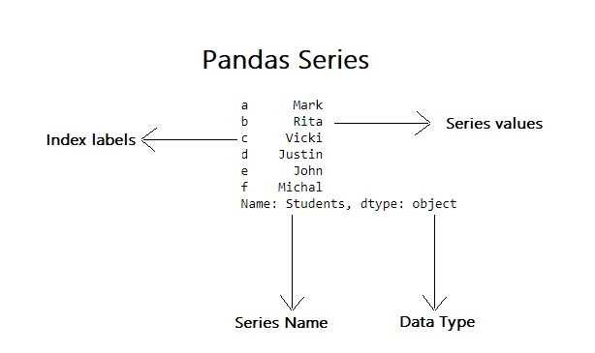
Pandas
Pandas is a python library designed for data analysis
Series
Data frame
Series
Pandas series is a 1D data structure. It is similar to a column in a table
import pandas as pd
x = [“a”,”b”,”c”]
data_series = pd.Series(x)
print(data_series )

Slide 2
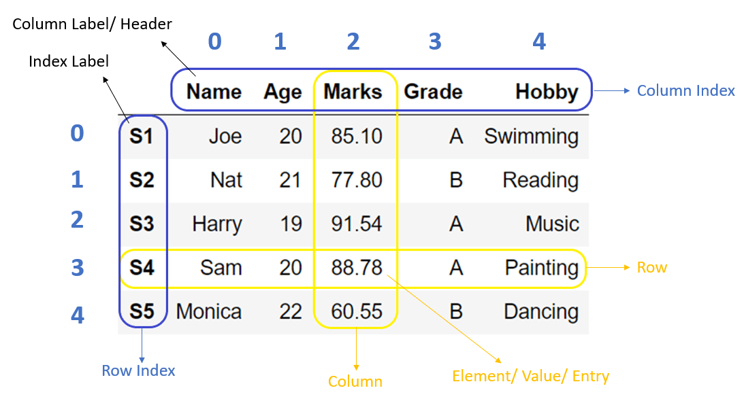
Data frame
Pandas data frame is a 2D data structure. It is similar to a table with columns and rows
import pandas as pd
dict = {
“name ”:[“john”,”alan”],
“marks ”:[50,70]
}
df = pd.DataFrame(dict)
print(df [column][row])

Slide 3
Selecting specific column of a data frame
x = df.Grade
print(x)
x = df[“Grade”]
print(x)
x = df[[“Grade”]]
print(x)
Selecting specific row of a data frame
x = df.loc[0]
print(x)
x = df.loc[[0]]
print(x)

Slide 4
Selecting rows by column values
x = df.loc[df.Age > 20]
print(x)
x = df.loc[df.Marks >85]
print(x)
x = df.loc[df.Marks >85][“Name”]
print(x)

Slide 5
Iterating columns in a data frame
for i in df.index:
print(df.Name[i])
for i in df.index:
print(df.Age[i])
for i in df.index:
print(df.Grade[i])

